Slide 1

Colon disease image classifier
Jacinda Garcia 6-10-2023

Slide 2
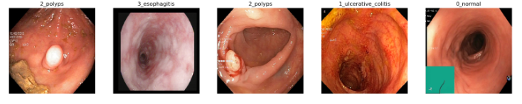
Background
Problem Statement
15 million colonoscopies were performed in 2012, but only half of people 50 -75 were up to date on screening (CDC). The CDC brought forth an initiative to increase screening compliance to 80 percent, and new methods for screening are less invasive and performed out of office. An increase in workload puts strain on physicians reviewing pathological images. A model that is able to classify image disease class could reduce the strain on workload significantly.

Slide 3
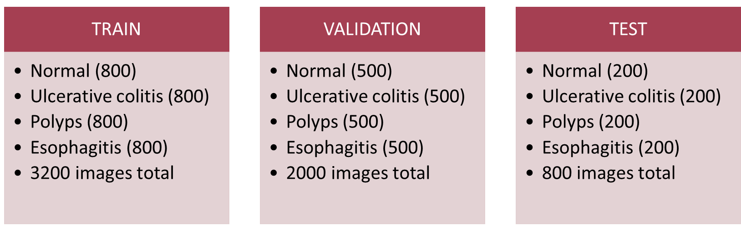
Data Wrangling
Notes:
The distribution of disease classes in the dataset is even among all sets. No further work was needed in preventing overfitting for a certain disease class or making sure one image class was not underrepresented. Image size for all images was (256,256,3)

Slide 4
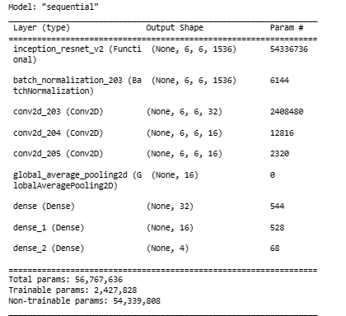
Modelling
Notes:
Transfer learning was applied as a base model using InceptionResNetV2. Resdiual layers were added including batch normalization, 3 convolution layers, 1 global averaging layers, and 3 dense layers with the final dense layer having a final output of 4, for the 4 class categories we want specified.

Slide 5
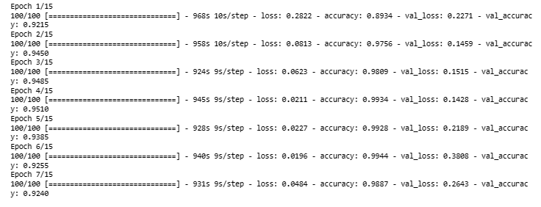
Modelling
Notes:
A call back function was implemented in the model to stop epochs being run early if no improvements were made to accuracy within 3 eopachs. Total epochs ran were 7 showing the low cost of this model.

Slide 6
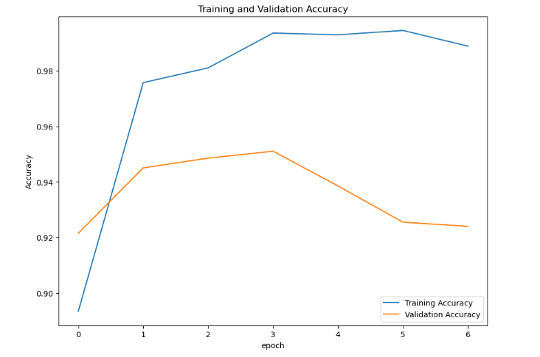
Model Evaluation
Notes:
This figure shows model accuracy for train and validation set predictions. Note that the scale starts at zero with that being the first epoch ran. Epoch 4 is the best model with accuracies of 99 and 95 percent respectively

Slide 7
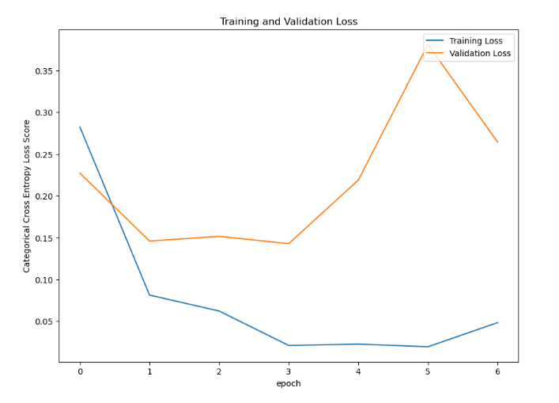
Model Evaluation
Notes:
This figure shows model loss (estimated with categorical cross entropy) for train and validation set predictions. Note that the scale starts at zero with that being the first epoch ran. Epoch 4 is the best model with loss of train and validation sets being .02 and 0.14 respectively.

Slide 8
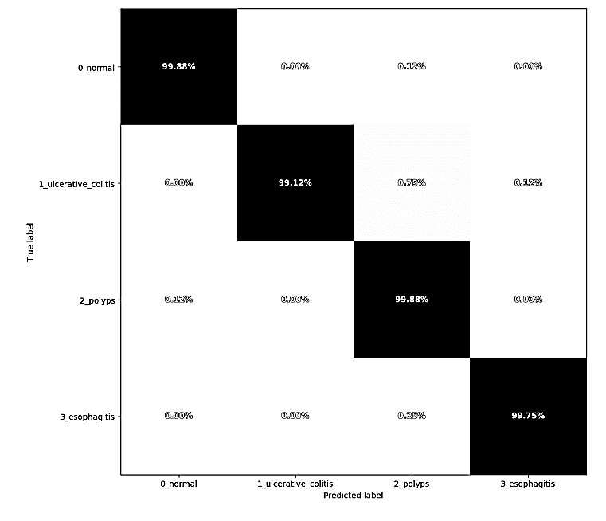
Model Prediction on Train set
Notes:
The confusion matrix for the true train set labels versus class labels predicted by the model. Each category class for the train set has over 99 percent accuracy. Only 0.12% of a disease image class(polyps) was classified as normal and vice versa for normal class.

Slide 9
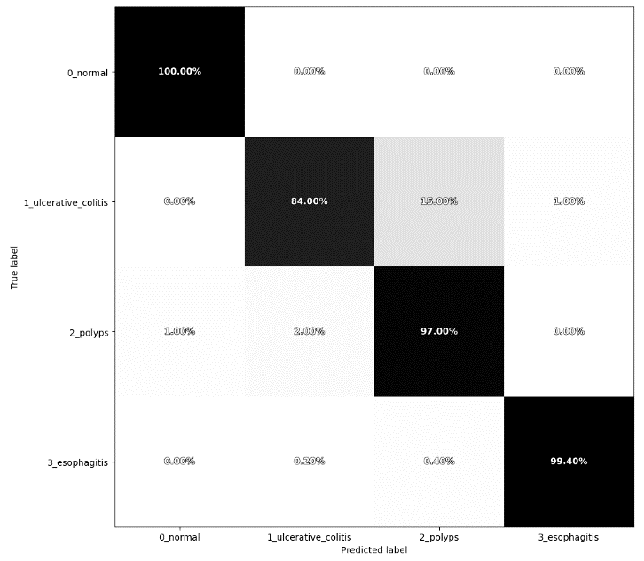
Model Prediction on Validation set
Notes:
The confusion matrix for the true validation set labels versus class labels predicted by the model.
Normal and esophagitis class predictions were above 99 percent, with polyp class prediction at 97 percent. The ulcerative colitis class had only 84 percent accuracy, but it should be noted that the other predictions made by the model were for disease classes, no predictions for ulcerative colitis were made under the normal class. This shows that the model is efficient at predicting between normal and diseased colon images.

Slide 10
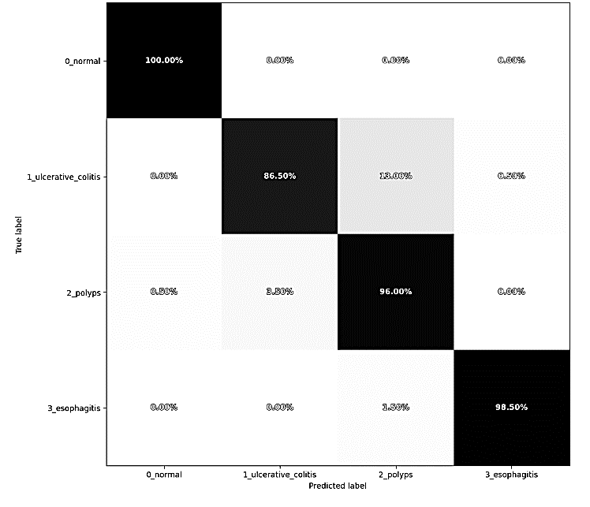
Model Prediction on Test set
Notes:
The confusion matrix for the true test set labels versus class labels predicted by the model.
Normal class colons had 100 percent accuracy. Esophagitis and polyp class prediction accuracy was at 98.5 and 96 percent, respectively. The ulcerative colitis class had only 86 percent accuracy, like the validation set, the other predictions made by the model were for diseased classes.

Slide 11
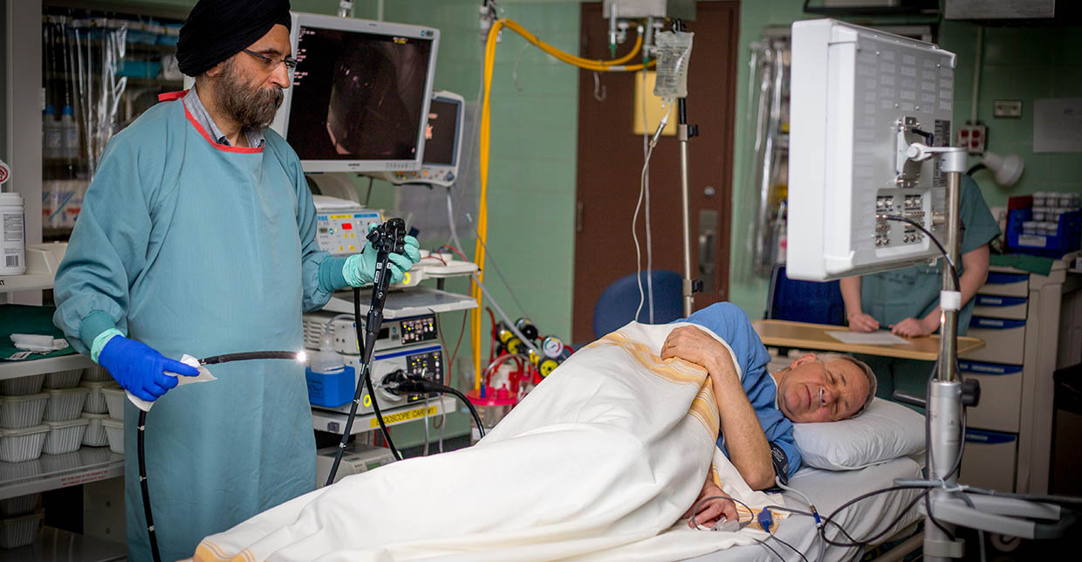
Conclusion
This Photo by Unknown Author is licensed under CC BY
Notes:
As medical advancements continue to be made, invasive procedures like a colonoscopy may become rare, but the image data from patients is likely to increase. Deep neural network models will play a vital role in handling the increase in workload. The image shown here may be a part of the past, and the future is a pill swallowed while an image classifier alerts physicians on disease, so they can take the appropriate course for treatment.

Slide 12
Resources
https://www.kaggle.com/datasets/francismon/curated-colon-dataset-for-deep-learning
https://www.mayoclinic.org/tests-procedures/capsule-endoscopy/about/pac-20393366
https://www.cdc.gov/media/releases/2016/p0622-colorectal-cancer-screening.html#print
https://www.tensorflow.org/api_docs/python/tf/keras/layers
https://keras.io/api/applications/inceptionresnetv2/
https://arxiv.org/abs/1602.07261

